Slide 1

How to
Set Up a Server and a Client

Slide 2
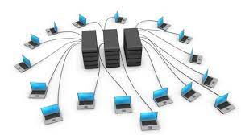
The First Internet: ARPANET
Using a computer required sitting at a terminal connected to a central computer (mainframe)
Paul Baran developed the idea of packet communication (small groups of data sent along different paths to a destination)
Robert Taylor had 3 different computer terminals connected to 3 mainframe computers in his office→Can one terminal be used for a computer?

Slide 3
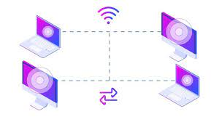
Transmission Control Protocol (TCP)
Enables communication between different networks by providing universal standard for data transmission
Simplifies the complexity of each network's operations, enabling devices to communicate regardless of the specific technologies or equipment

Slide 4
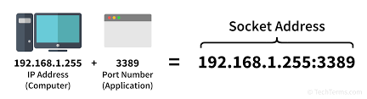
Sockets and Ports
A socket is one endpoint of a two-way communication link between two programs running on the network; identified by IP Address and Port number
A socket is bound to a port number so the TCP layer can uniquely identify a connection endpoint and direct data to its specific destination

Slide 5
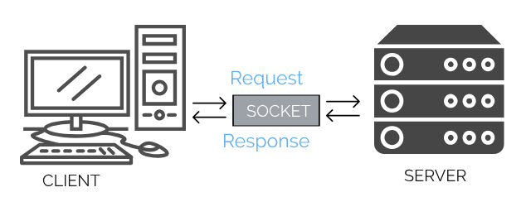
Socket Programming
Way of connecting two nodes on a network to communicate, using TCP/IP protocols through sockets→establishes a connection between a client and a server
A server waits for a connection from the client, who initiates the connection

Slide 6
The Berkeley Socket (1983)
Berkeley Software Distribution version of Unix
API implementation of the TCP protocol used by all operating systems
Function call is the same for other programming languages

Slide 7
Server
socket()
bind()
listen()
accept()
recv()
send()
close()
Client
socket()
connect()
send()
recv()
close()

Slide 8
Code Requirements
Create a socket (both client and server)
(Server) Bind the socket to a specific local address (machine's IP address) and port number
(Server) Passively listens for incoming connections

Slide 9
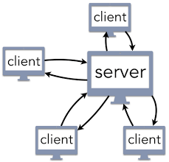
Multiple Client Connections
For multiple client connections to one port, distinguish between clients with the source IP Address
Distinguish between multiple connections from the same IP address with the incoming packet’s source IP address and port number

Slide 10
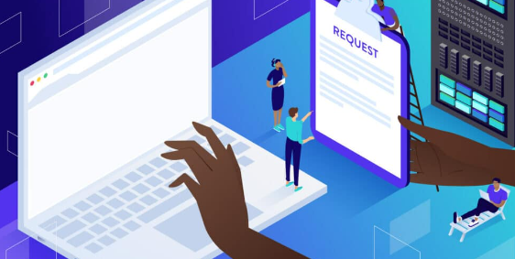
Everyday Server Use
Hypertext Transfer Protocol (HTTP):
request-response protocol
allows interaction with web resources by transmitting hypertext messages between clients and servers

Slide 11

Google Search
The client initiates a TCP connection to the server by creating a socket; the server accepts
The client sends an HTTP request over the established TCP connection.
The server sends an HTTP response back to client (the image) over the same TCP connection.

Slide 12

Demo: Create a Simple Chat Program

Slide 13

realpython.com:
Offers detailed guide of Python Socket Implementation
Geeks for Geeks
Client-Server in C, Java
techtarget.com
Articles on related concepts
More Resources

Slide 14
Thank you! Questions?

